Slide 1
NON-VERBAL COMMUNICATION

Slide 2

Nonverbal Communication
Nonverbal Communication: a system of symbolic behaviors that includes all forms of communication except words.
“The most important thing in communication is to hear what isn’t being said.”

Slide 3
Nonverbal communication

Slide 4
IMPORTANT NON-VERBAL SIGNALS
Facial Expressions
Gestures
Posture
Eye Contact
Vocal Characteristics
Personal Appearance
Haptics
Space
Chronemics

Slide 5
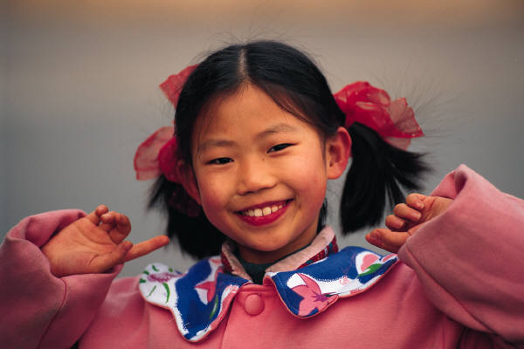
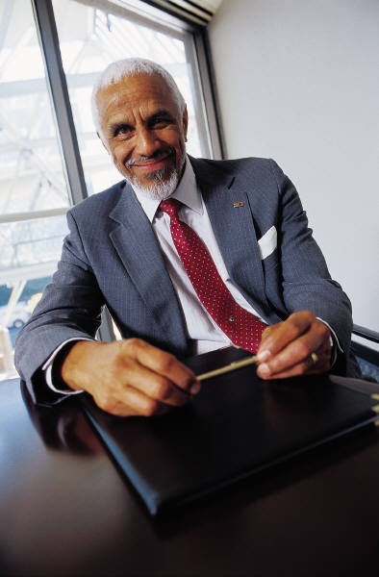
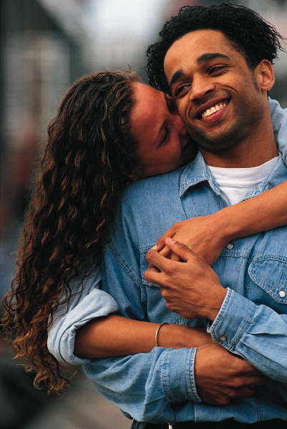

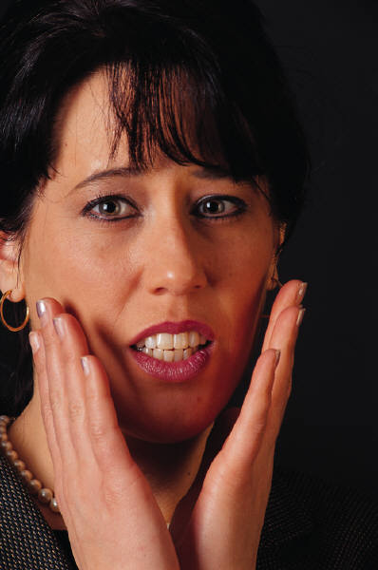
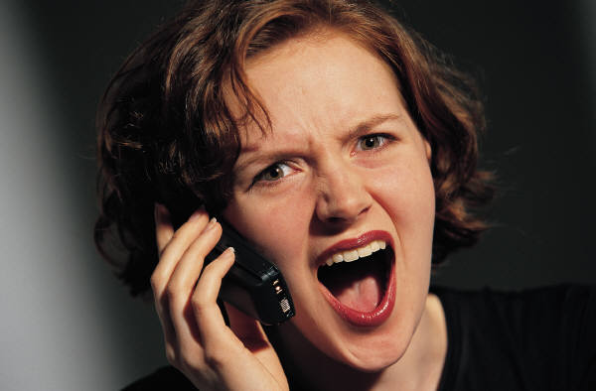
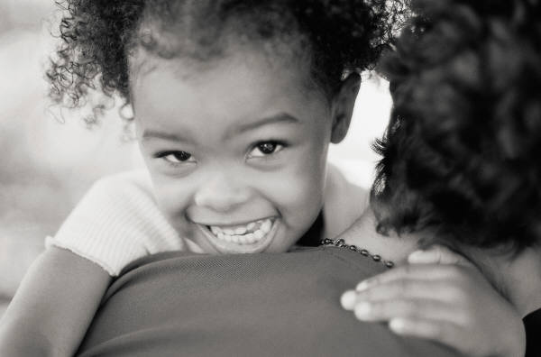
Facial Expressions
Facial Management
250,000 facial expressions

Slide 6
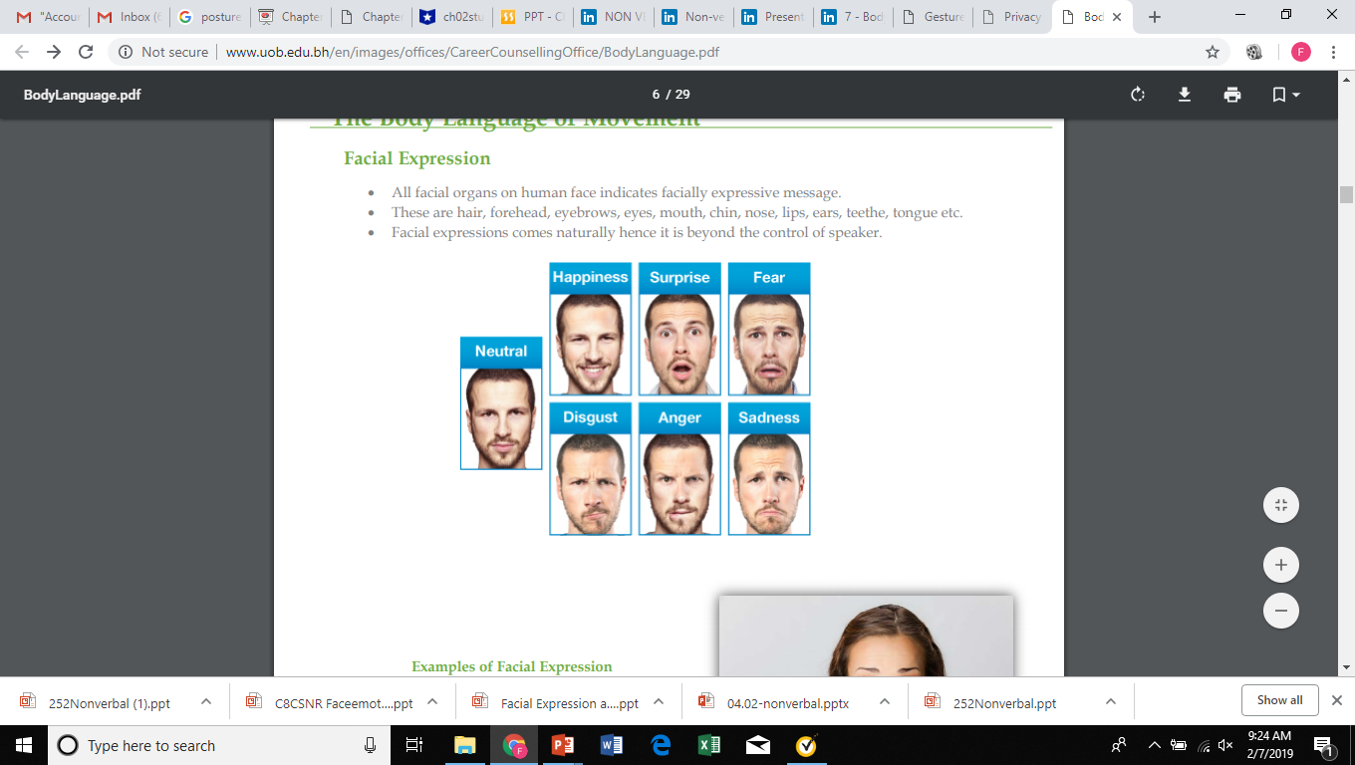

Slide 7
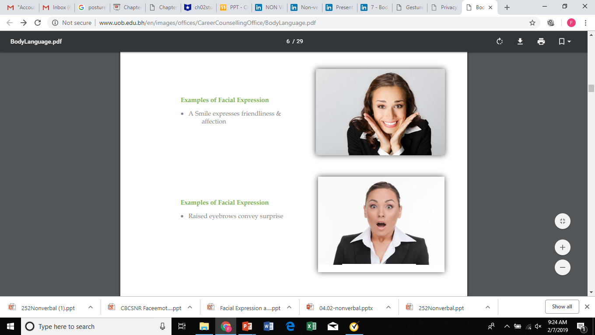
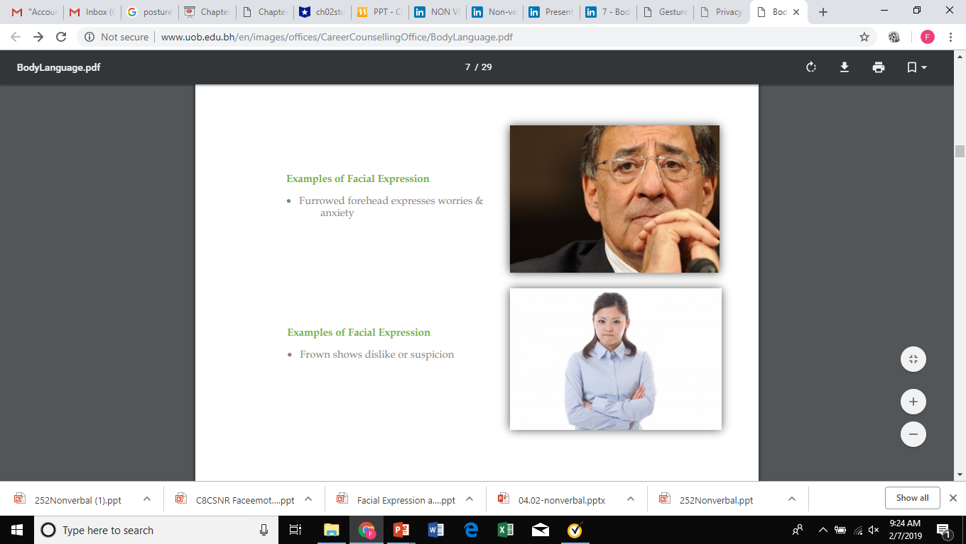
A Smile expresses friendliness & affection
Raised eyebrows convey surprise
Furrowed forehead expresses worries & anxiety
Frown shows dislike or suspicion

Slide 8
Facial Management Techniques
Intensifying – to exaggerate a feeling
Deintensifying – to underplay a feeling
Neutralizing – to hide a feeling
Masking – to replace or substitute the expression of one emotion or another

Slide 9
Facial Expressions in different Cultures
Americans smile freely at strangers.
Asians smile not only to express joy and friendliness but also to convey pain and embarrassment.
Russians consider smiling strange and even impolite.
Latin and Arabic cultures, exaggerate grief or sadness while most Americans hide grief or sorrow.

Slide 10
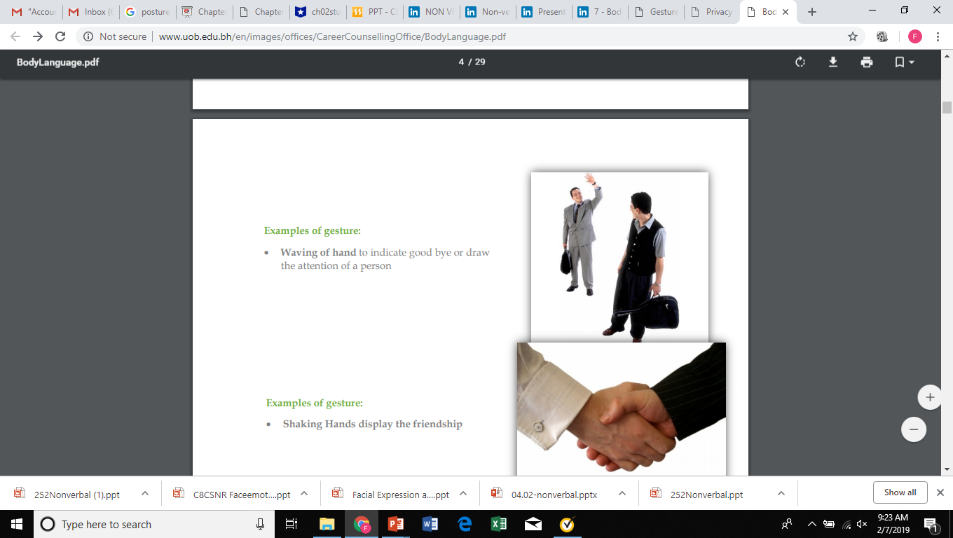
Gestures
Waving of hand to indicate good bye or draw the attention of a person

Slide 11
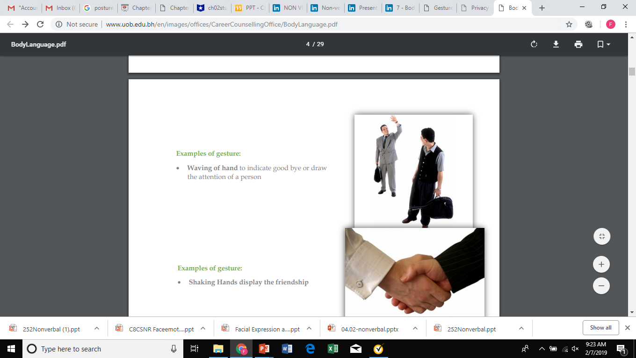
Shaking Hands display the friendship

Slide 12
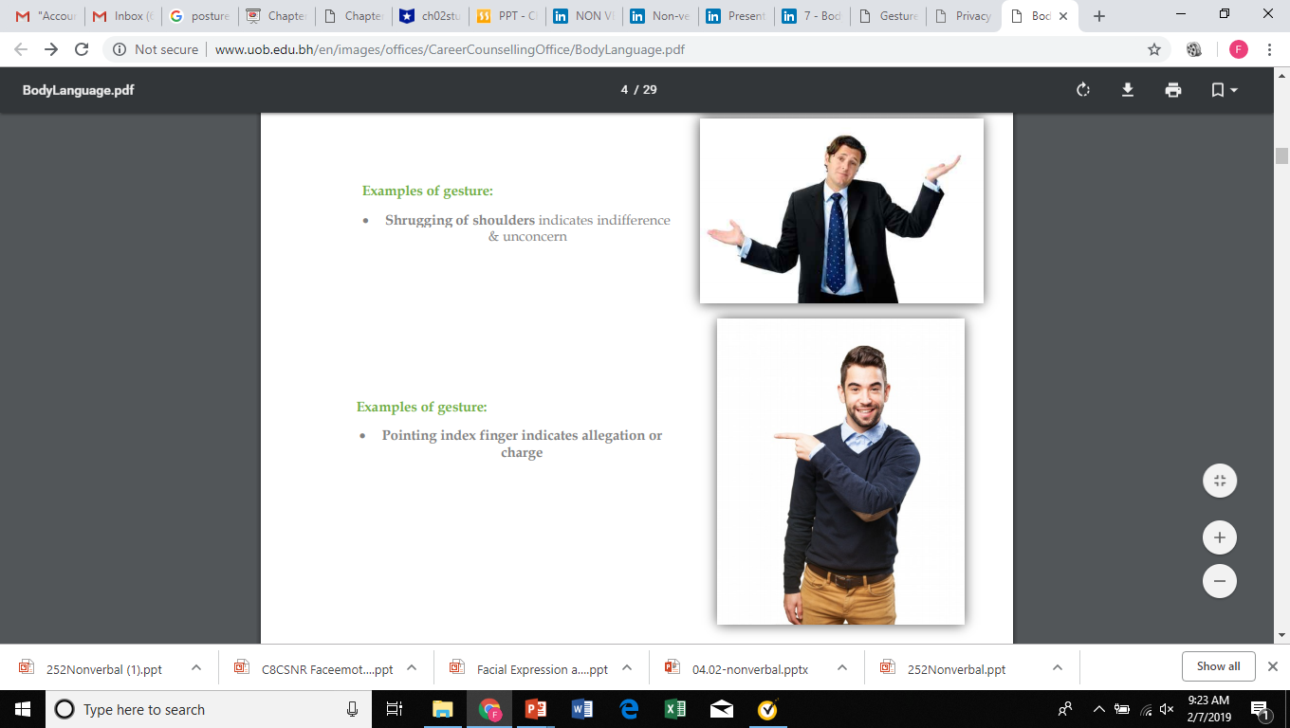
Shrugging of shoulders indicates indifference & unconcern

Slide 13
Pointing index finger indicates allegation or charge

Slide 14
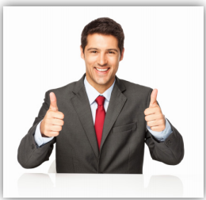
Thumbs up sign indicates wishing “Good Luck”

Slide 15
Gestures in Different Cultures
In the Middle East, nodding the head down indicates agreement.
In Japan, an up-and-down nod might just be a signal that someone is listening .
Americans and Chinese; nodding or moving the head up and down means “Yes” and shaking the head from one side to the other means “No”.
In India, nodding the head means “No” while shaking it means “Yes”

Slide 16
Bowing is criticized or rejected in the US, but in Japan, it indicates respect and an acknowledgment of rank.
The thumbs-up signal is vulgar in Iran and Latin America.
“Ok” signal, refers to money while in others, it is an extremely offensive.
Americans use index finger; Germans use their little finger, Japanese and Thais use their entire hand to point.
To start counting, the Germans use their thumb; the Japanese use their little finger ; the Indonesians use their middle finger
Some countries consider a handshake rude.
In Middle East, it is always rude to hand an object to another person with your left hand.
While burping after a meal is considered the height of rudeness in US, a heartily burp is a sign of appreciation for the cook in India.

Slide 17
Posture
Means “an attitude or position of body”
Each movement of body has expressive & defensive functions.
The way, in which we sit or stand, walk in walk out tells a lot about us.
A good posture indicates confident attitude.

Slide 18
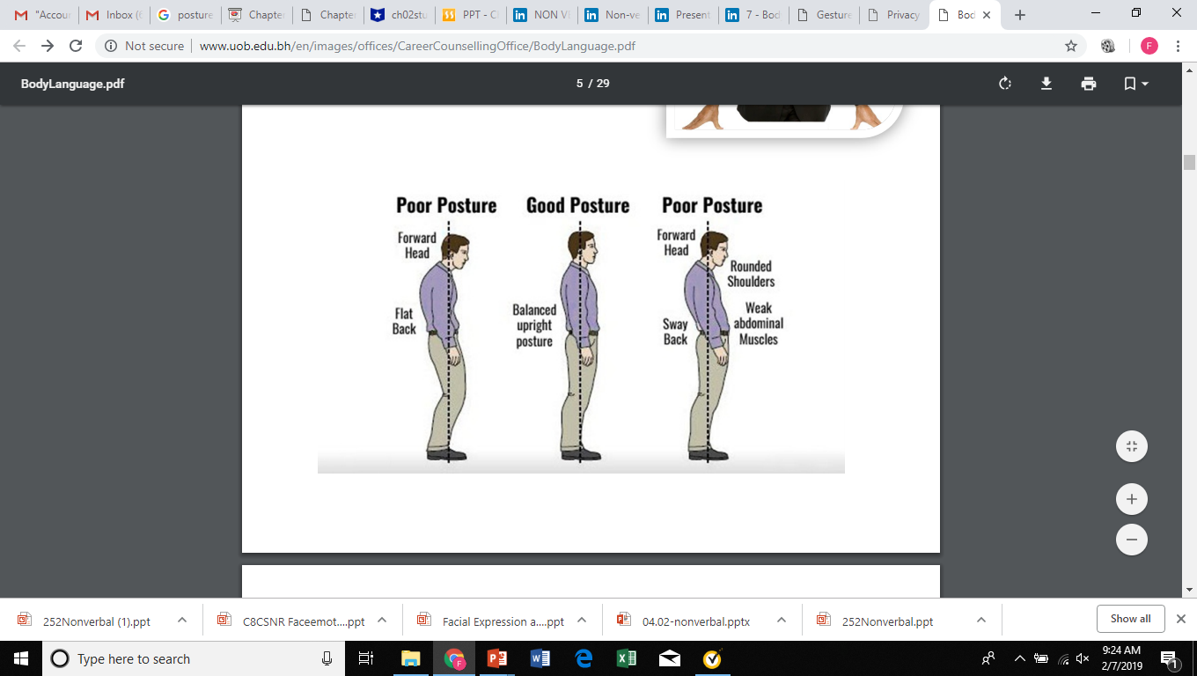

Slide 19
In different Cultures
Resting the feet on the desk while sitting is common among Americans.
In Asia, Middle East and Europe, it is considered as highly offensive.
Slouching is rude in most of Northern Europe and even in some Asian countries.
Putting hands inside the pocket while standing is disrespectful in Turkey.
Sitting with legs crossed is offensive in Ghana.
In Thailand, Cambodia, and Saudi Arabia, showing the sole of the feet while sitting in formal gatherings is offensive.

Slide 20
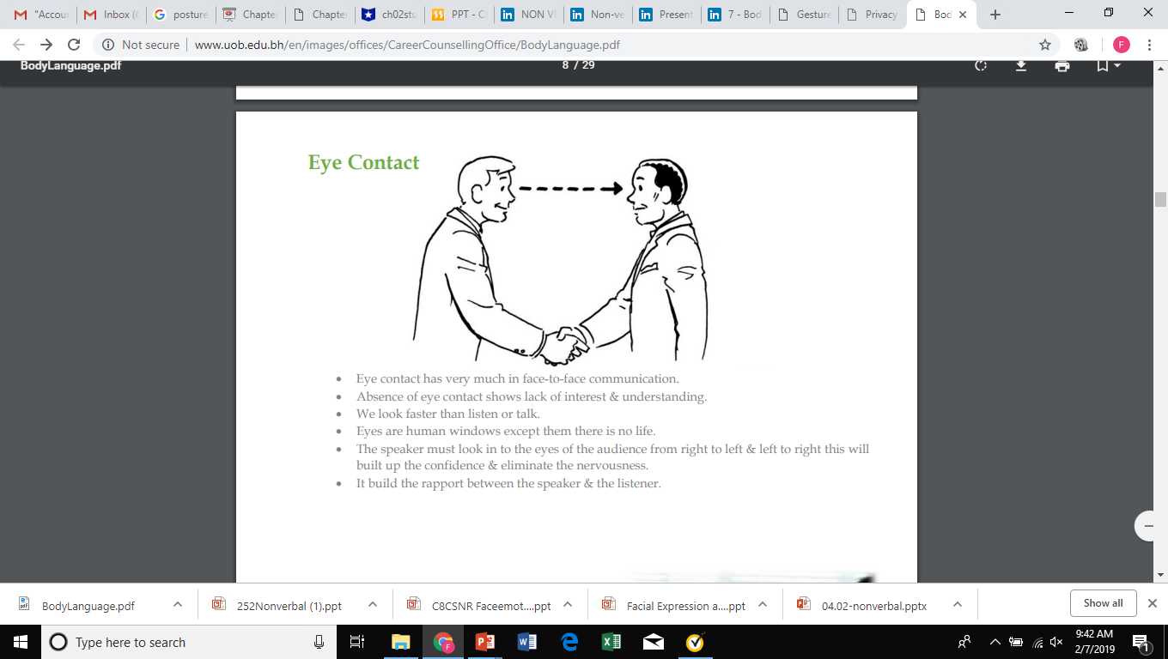
Eye Contact
Eye contact has very much in face-to-face communication.
Absence of eye contact shows lack of interest & understanding.
We see faster than listen or talk.
Eyes are human windows except them there is no life.
The speaker must look in to the eyes of the audience from right to left & left to right this will built up the confidence & eliminate the nervousness.
It builds the rapport between the speaker & the listener.

Slide 21
Eye Contact in different Cultures
Americans look directly in each other’s eyes when talking.
Most Western people think that if people are afraid to look others in the eye, means they are hiding something or lying.
In China, long eye contact makes people weird and people frequently avoid direct eye contact with others.
In Japan and Africa, prolonged eye contact is offensive and disrespectful.
In Arabic cultures, prolonged eye contact shows interest and helps them understand the other person.
People from Africa, Latin America and the Caribbean avoid eye contact to show respect.

Slide 22
HAPTICS (touch)
Asians do more touching than Americans.
In China, a lot of girls like holding each other’s hand or putting an arm on the other’s shoulder while walking on the streets.
In some cultures, patting a child’s head is affectionate or friendly except Asian countries.

Slide 23
Vocal Characteristics
Rate: how fast you talk
A normal rate of speech is about 120 words per minute.
A slow rate can indicate that you are uninterested in either your topic or the audience.
An extremely fast speaker risks the audience missing key words. The key here is variation.
Use your rate of speech to capture and hold your audience’s attention.
A faster rate of speech can suggest excitement or sudden action; slower rates indicate calm.

Slide 24
Volume
You want your volume to carry to the back of the room while not overpowering those in the first row.
It takes practice to trust your judgment on whether your volume is effective.
Speaking too soft can make you appear shy or unassertive.
It can give the impression that you are less confident in your topic. Or it can just wear out an audience trying to hear.
Speaking too loud can make you seem overbearing, arrogant or unpracticed with the sound equipment.
But varying the volume can be an effective way to add emphasis or emotion.

Slide 25
Pitch
Pitch is how high or low your voice is.
Your normal pitch is physiological, produced from the vibration of your vocal chords across your larynx.
But our voices are not monotone; we all have a vocal range in speaking just the same as in singing.
If something is serious, a credible speaker’s voice will go into a lower range.
The higher range is used for exciting or upbeat topics.

Slide 26
Pause
Pauses are your punctuation.
They provide a transition between points and add clarity to your words.
They also give you a chance to catch your breath and the audience to catch up with your ideas.
Pause to add emphasis, to build up to something important, or to allow a moment for an idea to sink in.

Slide 27
Articulation/Pronunciation
Articulation is the art of speaking clearly, making the proper sounds with your lips, teeth and tongue.
Pronunciation is saying a word phonetically correct.
Whether fairly or unfairly, both influence the audience’s impression of your command of the English language.
“Want to” often comes out “wanna.” “Athlete” comes out sounding like “Athalete.”

Slide 28
Personal Appearance
The kind of dress we use & the way in which we groom ourselves shows our status & attitude.
• We influenced how others look & clothes they wear
• Physical attractiveness plays an important role in our assessment of people.
• Persons dress & physical appearance conveys great deal of information about him.

Slide 29
Jewelry
One to two rings per hand
One earring per ear only
One bracelet, watch, or bangle per wrist
One necklace or pendant
Tattoos
no visible tattoos
Body piercing
No visible piercing other than ears
Single earring per ear—no multiple piercing

Slide 30
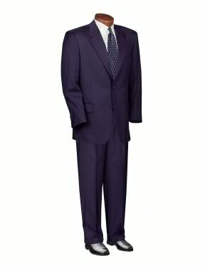
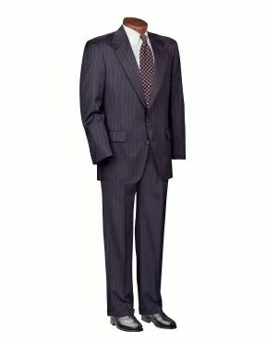
MEN BUSINESS WEAR

Slide 31
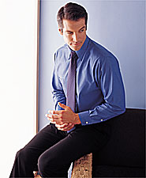
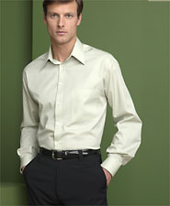
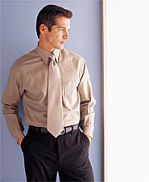
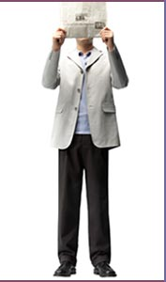

MEN’S BUSINESS CASUAL

Slide 32
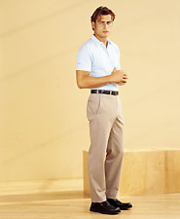
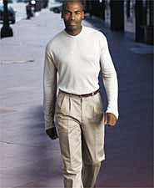
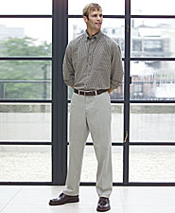
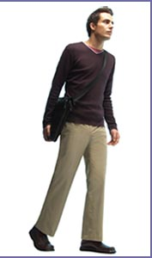
MEN’S CASUAL

Slide 33
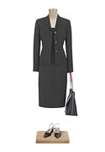
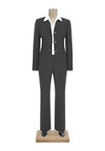
WOMEN BUSINESS WEAR

Slide 34
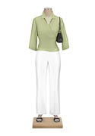
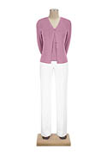
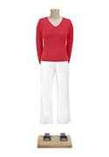
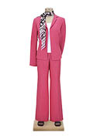
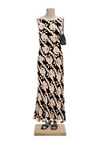
WOMEN’S BUSINESS CASUAL

Slide 35
Space
Spacial Distances–
Intimate zone (1 – 1.5 feet)
– Personal zone (1.5 – 4 feet)
– Social zone (4-12 feet)
– Public zone (12’ - ∞)

Slide 36
Chronemics
This is the use of time.
How we use time, our punctuality in arriving or departing, and what our routines are says a lot about who we are.
Some of us live by the clock – regimented and controlled by it.
Others of us are more free spirits – we come and go on our whims.

Slide 37
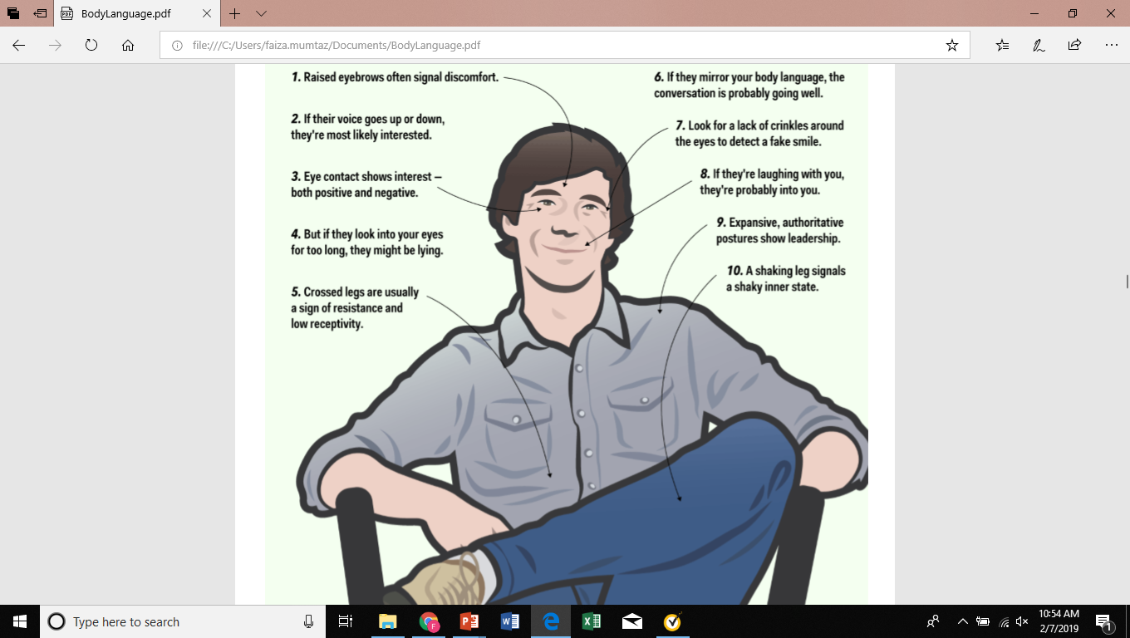

Slide 38
1- SMILE!
2- Keep an open space before your upper torso. E.g. don’t fold your arms, hug your bag, or put things on your lap.
3- Have eye contact. Important to establish connection.
4- Be comfortable in your space. Don’t fidget, don’t squirm, or don’t lose yourself in your body.
5- (For ladies) When resting on your hand, keep the insides of your hand faced outwards. This makes you appear more open.
6- Minimize movement that distracts. Don’t finger drum, nail bite, skin peel, or scab pick.
7- Slow down your pace. (for fast talkers). Move slowly if you have to adjust your position.
8- Be inclusive in your actions. E.g. reduce the physical distance between you and the other person, smile, maintain eye contact, and make occasional gestures towards the other person.
9- Be open with your emotions. If you are sad, happy, or surprised, show that on your face.
10- Pace yourself to much the other person. At the end of the day, everyone is different. Assess each person individually and adopt the body language that will help you best connect with him/her.

Slide 39
DO:
MAKE AN ENTRANCE
COMMAND ATTENTION
PROPER POSTURE
SMILE WITH CONFIDENCE
FIRM HANDSHAKE
DIRECT EYE CONTACT
SPEAK LOUDLY ENOUGH TO BE HEARD CLEARLY
DRESS APPROPRIATELY
DON’T:
TURN YOUR BACK ON THE AUDIENCE
LOSE EYE CONTACT
HAVE A LIMP HANDSHAKE
FIDGET, SQUIRM, SLOUCH
SPEAK TOO SOFTLY TO BE HEARD CLEARLY
CHEW GUM
APPEAR DISINTERESTED

